Slide 1

Inside the Machine
Amod Malviya
Notes:
First half - overview, 2nd half - deeper

Slide 2
Mindset & Principles
Reasoning >> facts
Thinking is mandatory!
We cannot reason without asking questions. So question!
I will lie!
I will lie only about “facts”, not about “method of reasoning”.
You cannot counter with a looked-up fact. Only reasoning.

Slide 3
Why understand internals?

Slide 4

Webserver
Perf increase?
10x
50%
1.8x
50%
compute
network + disk
40%
1.56x
60%

Slide 5
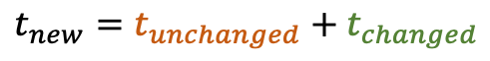

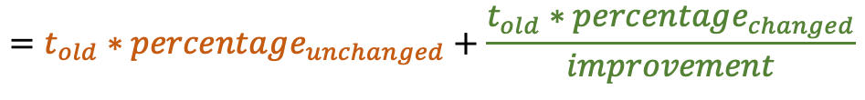
Amdahl’s Law
$$t_{new}=t_{unchanged}+t_{changed}$$
$$=t_{old}∗percentage_{unchanged}+\frac{t_{old}∗percentage_{changed}}{improvement}$$
$$≤t_{old}∗percentage_{unchanged}$$
improvement -> ∞
Max gain possible is always constrained by the unchanged part
Law of diminishing returns
(of improving only one part)
You’re always chasing the next bottleneck
(which there are many)
Notes:
Assignment: In the 40-60 scenario, what amount of CPU improvement will lead to 80% of max gains possible?

Slide 6
Why understand internals?
Understand the bottlenecks - we cannot improve what we do not understand
Good engineering requires good/innovative use of resources
Gives a lens to understanding a large number of programs
Get better at tech support for friends & family
Notes:
Databases, Redis, OS, Network, Distributed Systems

Slide 7
High Level Overview

Slide 8
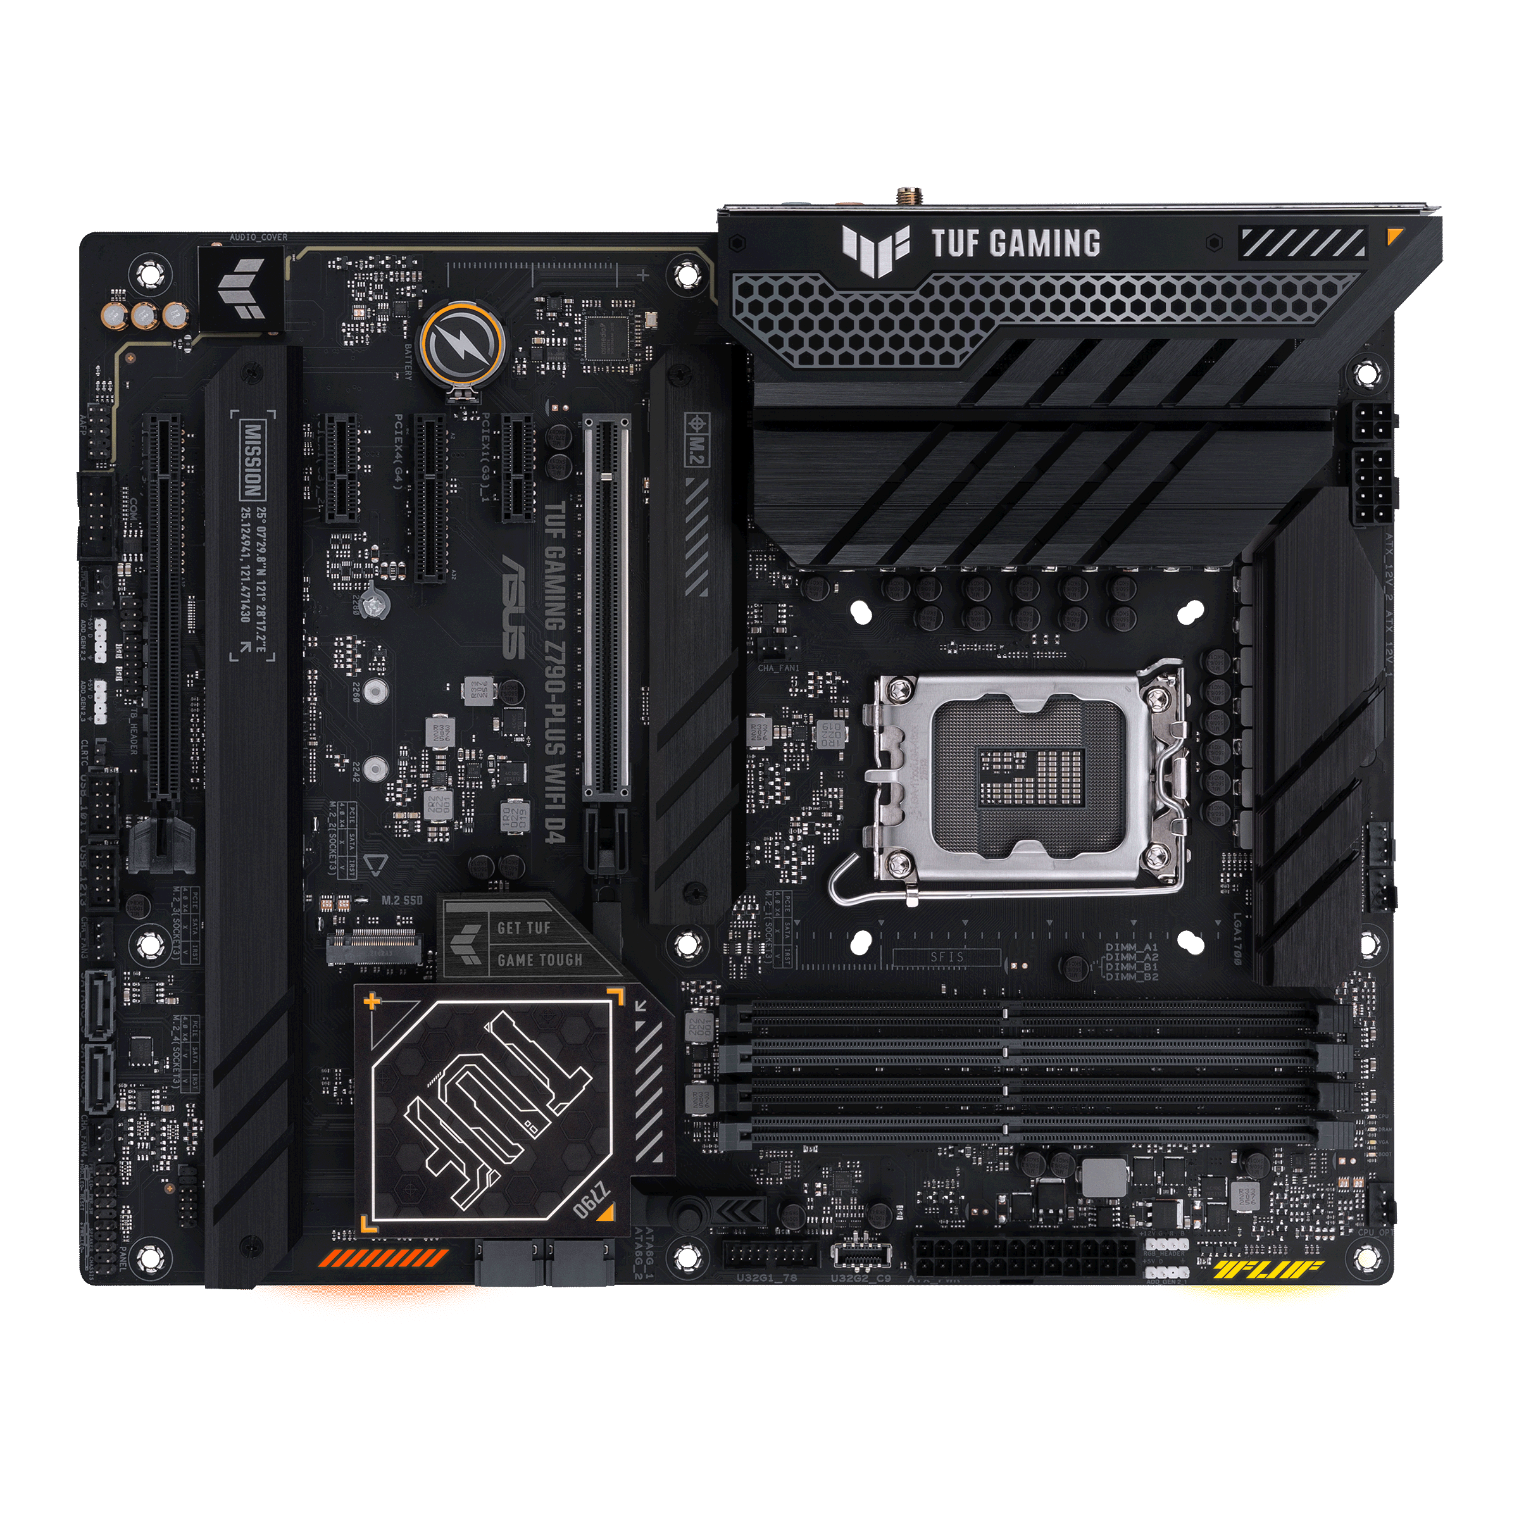
Ports
VRM
PCIe slots
CPU Socket
PCIe x16 slots
SATA & M.2
Memory
Chipset
Asus Z790 mobo
Notes:
How many can we identify?
How do we characterize each one of them?

Slide 9






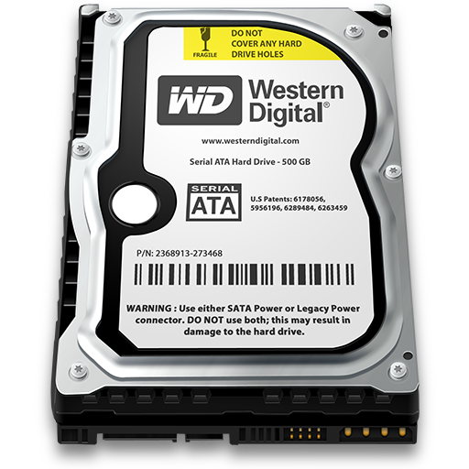

CPU
sync ifc
(mostly)
GPU
Memory
Connectivity?
PCIe card
NVMe SSD
I/O
USB
What’s the difference ?!
async ifc
(mostly)
SATA Disk
Ethernet
Notes:
Difference b/w IO vs Mem – slow/fast? privilege? async?
Q: What’s common between all I/O devices?
Q: Why *should* mem be sync? (Assignment)
Q: Why *should* IO mostly be async? Unbounded behaviour.
Either better CPU/IO/Mem, or the connectivity

Slide 10
Computer Performance is mostly architecting Compute, Memory, I/O & Connectivity
Hardware
AND
Software
Latency & Throughput

Slide 11






Throughput helps hide latency
only if designed to do so
5 pooris max
1 min fry-time
Throughput’s only purpose is to
hide latency
Customer
Stall
Orders (poori)
Latency/order
Throughput
AvgLat/order
Throughput
Utilization
2
1 m
2 ppm
1 m
2 ppm
40%
(bandwidth: 5ppm)
2
+ 3
1 m, 2m
2 ppm, 3 ppm
1.5 m
2.5 ppm
50%
2
+ 3
1 m, 1 m
2 ppm, 3 ppm
1 m
5 ppm
100%
7 + 10
?
?
?
?
?
Notes:
Q: Can throughput hide latency without limit?
Q: Other examples? Git commit, traffic, network, OS
Assignment: Complete the 7+10 example
Assignment: 3 examples of latency hiding via throughput (other than ones discussed)
Assignment: latency hiding via throughput in HTTP server

Slide 12

50 ns
Lies?
0.1ns
25 GB/s
CPU
PCIe 1x lane = 16 Gbps (PCIe 4.0)
DDR
GPU
Memory
x16 lanes
DMI / UMI
100+ns
1Gbps
4x 100Gbps PCIe NIC
NVMe SSD
x4 lanes
x4 lanes
10-100us
3 GB/s
Chipset
USB
2-10 ms
150 MB/s
SATA Disk
Ethernet
Notes:
Compute vs Mem vs IO bound
Q: Should the CPU directly support multiple kinds of IO?
Q: Is DMI part of the 20 lanes? Or in addition?
Q: Why is GPU connected to direct PCIe lane? Why x16?
Q: Would the chipset add latency?
Q: Why is memory b/w in GB/s while PCIe in Gbps
Q: Why is everything other than memory, a serial bus?
Assignment: Why do GPU carry their own memory?
Assignment: How would you think about bandwidth needed to drive a 8k monitor @60Hz (assume 8b each for RGB)? Compare your calculated bandwidth with the spec of the cable you use to connect. How many lanes of PCIe 4.0 would be needed to pump that throughput?
Web server

Slide 13
Break

Slide 14
DDR SDRAM
DDR4-3200
Lies?
25.6 GB/s
@3200 MT/s
64/72-wide
77-wide
DIMM is dumb!
Pure Capacitive Storage
Memory Controller
1600 MHz (double data pumping)
Latency – 50ns (because capacitive!)
Actual throughput achieved?
BURST - throughput hides latency!
One channel – 64-bit wide
Notes:
What is “Random Access”? What is “Dynamic”? What is “Synchronous”? What is “Double Data Rate”?
Variations in form factor: DIMM, SO-DIMM, LP-DIMM, RDIMM
DDR5 includes on-die ECC, has sub-channels (link ECC in LPDDR5)
Q: Why not go even wider?
Q: Why is memory controller on CPU instead of DRAM sticks?

Slide 15
Memory Hierarchy
Register
1 cycle
> 1 TB/s
Core 0
L1
5 cycles
1 TB/s
L3
L2
15 cycles
1 TB/s
Register File
L3
75 cycles
500 GB/s
L1
Memory Controller
DRAM
50ns
25 GB/s
L2
Cache
L1
Register File
2 channels, 64-bit wide
= 128-bit memory bus
= 2x mem bandwidth
Cache line
(64/128 B)
Core 1
Throughput hides latency!
Notes:
L1i / L1d
Cache line & burst length
Q: Why are L1/L2/L3 faster?
Q: Why measure L1/L2/L3 in cycles, while DRAM in ns? Clocks are different, DRAM number too large.
Q: If L1/L2/L3 are all SRAMs, why do L2 & L3 have higher latency? Higher tag lookups, contention
Q: Where might DCAS be getting implemented?
Q: Do you see why GC languages can be slow?

Slide 16
Multiple Processors
UPI/xGMI
Memory Controller
CPU0
CPU1
Memory Controller
Process
Fast
Slow
50 ns
100+ ns
Non-Unified Memory Access
(NUMA)
Notes:
OS scheduler will be NUMA aware
MESI protocol
Q: UPI vs PCIe

Slide 17
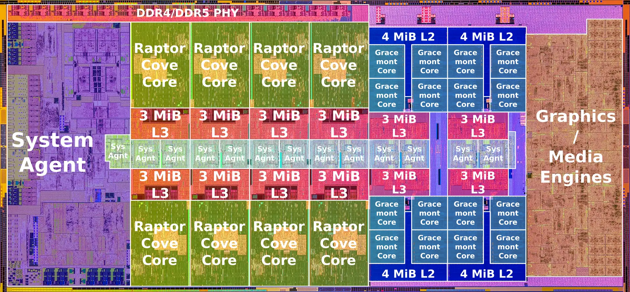
Raptor Lake Die
Credit: https://en.wikichip.org/wiki/intel/microarchitectures/raptor_lake
Notes:
Inter-core interconnect – ring bus

Slide 18
PCIe
Communication is packetized
CPU
Device
PCIe 4.0 – 16 GT/s
Transaction Layer
Transaction Layer
PCIe 5.0 – 32 GT/s
16 GT/s = 16 Gb/s = ~2GB/s
Data Link Layer
Data Link Layer
Higher latency because serial
Higher Throughput
hides a lot of that latency!
Physical Layer
Physical Layer
PIPE
RX
TX
RX
TX
1 lane
Notes:
Technically, not a bus
Packetized - switching
CXL & memory pooling – convergence of memory & I/O
Q: Can a PCIe length be extended forever?
Q: If we’re using x16 lanes, isn’t it “parallel” ?
Q: Why does CPU allow only fixed PCIe configs, e.g. 1x16 + 1x4?

Slide 19
SATA -> NVMe
NAND
Flash
NAND
Flash
NAND
Flash
NAND
Flash
NAND
Flash
NAND
Flash
NAND
Flash
NAND
Flash
NVMe
SATA
NAND
Flash
NAND
Flash
NAND
Flash
NAND
Flash
NAND
Flash
NAND
Flash
NAND
Flash
NAND
Flash
SATA Disk
SATA: 32-deep cmd queue, 6 Gb/s
Storage Medium: Magnetic, Optical, NAND
NVMe: 64k queues, 64k-deep cmd/queue
Throughput hides latency!
Protocol: SATA, SAS, NVMe
Form Factor: 2.5”, M.2, U.2
Speed is governed by both
Notes:
Storage Medium: ultimate bottleneck
Protocol: queue depth, latency

Slide 20
Register
Caches
DRAM
NVMe SSD
HDD
0.3ns
> 1TB/s
Wifi 6?
Wired LAN @1Gbps?
1-20 ns
1TB/s
DisplayPort?
Wired LAN @10Gbps?
15-90 ns
25 GB/s /channel @DDR4-3200
10-100 us
2+ GB/s
2-10 ms
150 MB/s
Notes:
Assignment: figure out latency & bandwidth of ones in red.

Slide 21
Summary
Amdahl’s Law
Performance is all about overall latency
Main memory is damn slow
I/O is muuuuuuch slower
Serial lines rule everywhere, except memory
All of system design is about hiding latency via throughput
True for hardware, true for software!

Slide 22
Thank You

